Slide 1
Visualization and Analysis of COVID-19 Spread Patterns
2310030218 2310030047 2310039455 2310039459 2310030069

Slide 2
Introduction and Timeline
COVID‑19 began in Wuhan, China in December 2019 and quickly spread globally by early 2020, becoming a pandemic. Early outbreaks were tracked via dashboards such as WHO’s and JHU’s, showing case counts, new daily cases (“epi‑curve”), deaths, and geographic distribution

Slide 3
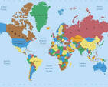
Geographic Spread & Maps
Choropleth world maps illustrate confirmed cases or deaths per million people – a relative metric that allows comparison across countries of different population sizes. Darker shades indicate higher burden. However, variations in testing capacity across regions must be considered when interpreting these maps
Stacked regional bar charts (e.g. cases by WHO region over time) offer temporal detail but require care in reading legends and axes; different testing/reporting regimes can skew interpretations

Slide 4
Temporal Trends & Epi‑Curves
Epidemic curves plot new confirmed cases by date of onset and help reveal whether transmission originates from point‑source, continuous source, or propagated spread. They also show if the outbreak is growing, plateauing, or declining
Log vs Linear scales:
Linear plots visually represent total case counts and make raw numbers easy to see.
Logarithmic scales are more helpful for detecting exponential growth and flattening trends. Comparing graphs only works if scales match

Slide 5
Statistical Distributions & Network Models
COVID‑19 cases across countries and regions often follow power-law distributions, meaning a few hotspots account for most cases. This dual‑scale phenomenon occurs both between countries and within regions
Network visualization: Studies use network analysis to illustrate pandemic risk based on interconnectivity and case arrival patterns. This helps model how regions are epidemiologically linked

Slide 6
Spatiotemporal Dynamics
Dynamic Mode Decomposition (DMD) analyses reveal that states like California, Louisiana, Kansas, Georgia, and Texas showed overlapping outbreak patterns in early US spread. These hidden modal structures help identify clusters of synchrony
In developing cities, especially in slums, small neighbourhoods contributed disproportionately to total cases. A self‑similar, scale‑invariant distribution suggests persistent inequality in outbreak impact

Slide 7
Visualization Tools & Dashboards
Tools such as Our World in Data, COVID‑19‑World, and dashboards from WHO, CDC, and SafeGraph have enabled interactive exploration of global and local trends. Many are open‑source and updated daily

Slide 8
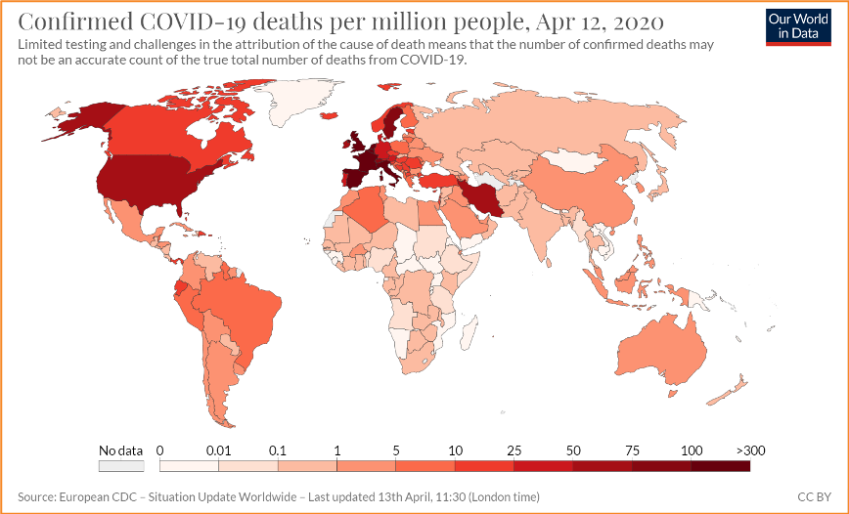
Example Visuals & Interpretation
A. Global Spread Map Highlights intensity across regions—Europe and Americas often showing darker shading. Use this to discuss regional testing/reporting differences.

Slide 9
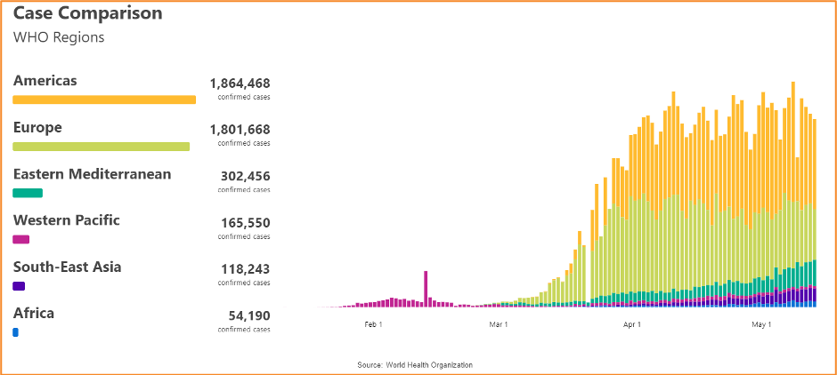
Stacked Region Cases Over Time Visualizes case trends across WHO regions; check scale and temporal alignment to draw valid comparisons.

Slide 10
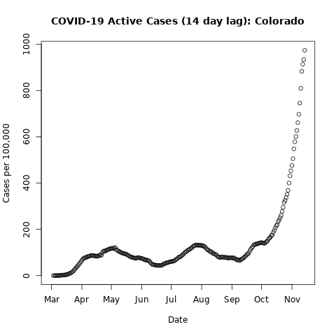
Epi‑Curve & Wave Patterns Reveals rise and fall of waves and can show effectiveness of interventions like lockdowns or vaccines.

Slide 11
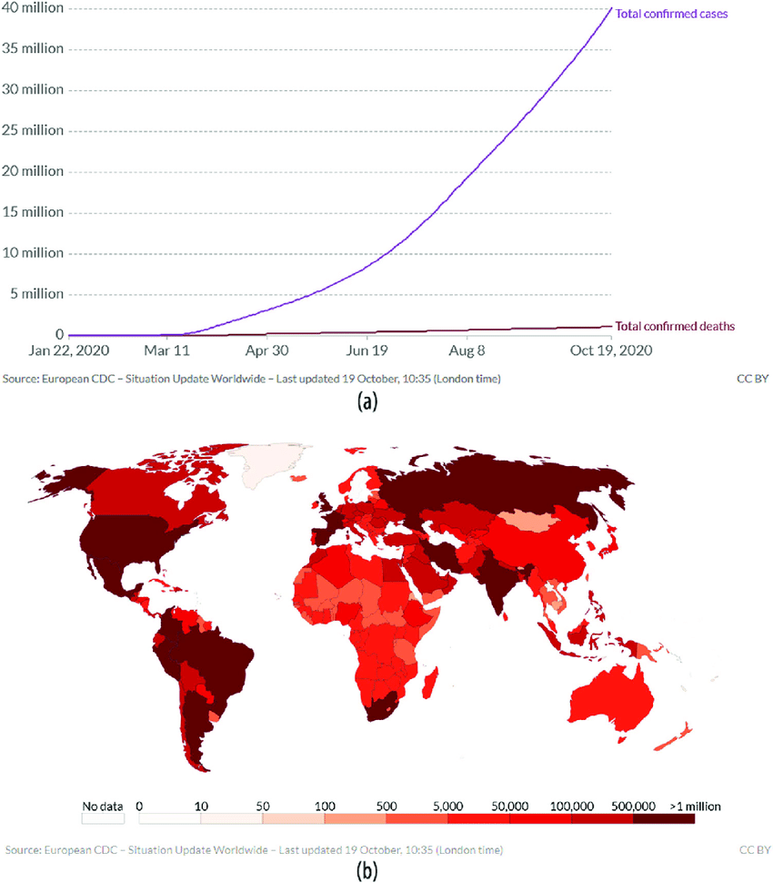
Power‑law & Hotspot Map Showcases how most cases concentrate in few major centres (e.g. global hotspots) and how growth accelerates early.

Slide 12
Analysis Summary & Key Insights
Relative metrics are critical: Cases per capita or deaths per million help compare diverse regions.
Scale matters: Always ensure visual scales match across comparative charts.
Disparities exist: Inequitable impact across socio-economic groups and geographies (e.g. slums) must be highlighted.
Tracking evolving hotspots: The geographic “eye” of the epidemic shifted over time (e.g. US from West to East to South etc.) demonstrating multiple, overlapping outbreak clusters .
Visualization tools improve comprehension: Interactive dashboards, network graphs, and topological maps help policymakers identify trends and risks in real time.

